Slide 1
Lead Scoring Analysis
By: Rufina D Costa, Ruchir Rastogi, Robinson Kotamraju

Slide 2
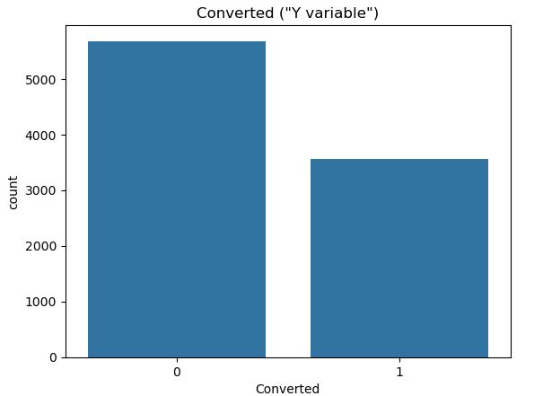
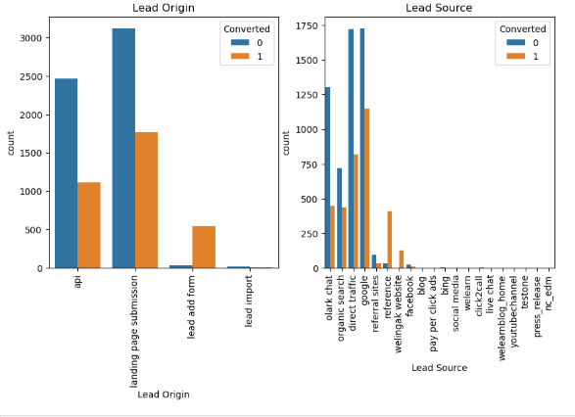
Exploring Initial Data
The overall conversion rate as per the available data is ~38.5%
This conversion rate accounts all the other parameters taken into consideration
Majority of these conversions are attributed to,
1) The origin being Landing Page
2) The source being Google

Slide 3
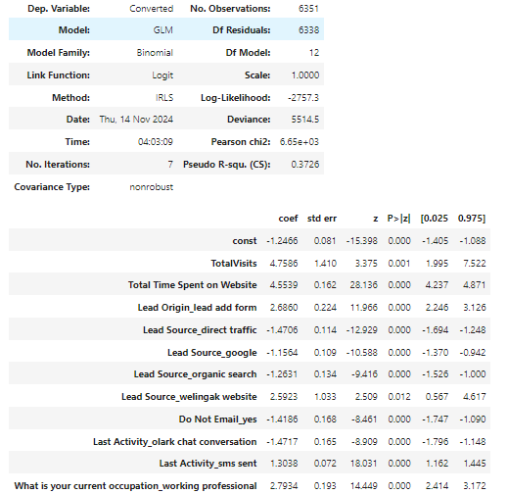
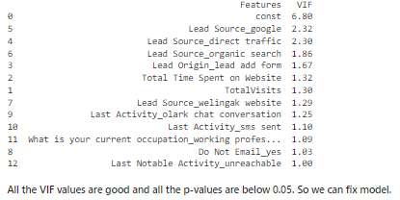
Feature Selection
The model-built post RFE indicates we had all the P values under 0.05 and VIF values below 2.5

Slide 4
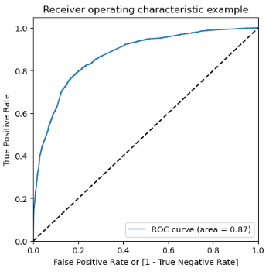
ROC Curve
The AUC score is 87% which is more than fair, if not excellent and it is a testament of how good the model is and also indicates that it was worth the test

Slide 5
Lead Score Conversion Predicted
The conversion score on the train data predicts a value of 80%
The conversion score on the test data predicts a value of 75.32%

Slide 6
Influencing Variables
Based on the lead score assigned for each of the leads, the few key influential variables were identified.
Total time spent
Total number of visits
Lead Source with following priorities
Google
Direct Traffic
Organic Search
Welingak Website
SMS
Olark chat conversations
Lead Origin
Lead add format
Occupation
Working Professional

Slide 7
Thank you!

